Slide 1
SQL 2016: Stretch Database - باللغة العربية
Ayman El-Ghazali

Slide 2
Agenda
What is Stretch Database?
Why use Stretch Database?
Under the Covers
Costs
Eligibility for “Stretching”
Demo

Slide 3
What is Stretch Database?
A cost effective way to store “cold” data remotely
Best of both worlds, keep data for as long as you need and reduce cost of storage on-premise
Application changes are not needed
Similarly to how Table Partitioning works, it is transparent to the application
Queries automatically stretch between on-premise and remote data
Security is applied locally, no need to reconfigure for data that is stored remotely
Backups will run faster and take less space
On-premise data is backed up locally
“Cold” data that is stretched to Azure is automatically backed up in the Cloud
Compatible with Row-Level Security, Always Encrypted, and TDE
Available in all SQL Server 2016 Editions
Compatible with Availability Groups

Slide 4
Why use Stretch Database?
If you're a decision maker | If you're a DBA
I have to keep transactional data for a long time. | The size of my tables is getting out of control.
Sometimes I have to query the historical data. | My users say that they want access to historical data, but they only rarely use it.
I have apps, including older apps, that I don’t want to update. | I have to keep buying and adding more storage.
I want to find a way to save money on storage. | I can’t backup or restore such large tables within the SLA.
https://msdn.microsoft.com/en-us/library/dn935011.aspx

Slide 5
Under the Covers
Stretch Database needs to be enabled at the Instance-Level, Database-Level and then on a specific Table
All or Something Rule
All of your data for a specific table can be migrated to the Cloud
Some of your data can be migrated to the Cloud based on a filter predicate
Filter predicate is created using a simple table valued function
Data Migration can be paused to reduce load on hardware resources and network bandwidth

Slide 6
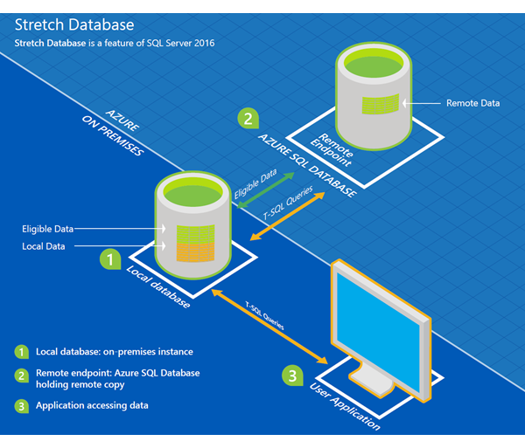

Slide 7
Eligibility for “Stretching”
Cannot do updates or deletes on the rows that have been migrated
Memory-optimized tables not eligible
Tables that are replicated are not eligible
Tables that are using Change Data Capture are not eligible
Tables with check, default, and foreign key (parent table) constraints are not eligible
Full list of limitations: https://msdn.microsoft.com/en-us/library/mt605114.aspx
Can run the SQL Server Upgrade Advisor > Stretch Advisor to help determine tables that are eligible

Slide 8
Costs
You are billed for each hour the Stretch database exists, regardless of activity or if the database exists for less than an hour, using the highest rate that applied during the hour. For example, if you create a Stretch Database and delete it 5 minutes later your bill will reflect a charge for 1 database hour. If you create a Stretch Database with 100 DSU and then immediately scale it up to 400 DSU, you will be charged at the 400 DSU rate for the first hour. If you delete a database and then create another with the same name, your bill will reflect a charge for two separate databases within that hour.*
Ranging from $1.25/hr - $25/hr and storage costs are computed separately*
https://azure.microsoft.com/en-us/pricing/details/sql-server-stretch-database/
*Potential to change in the future

Slide 9
Demo

